Slide 1
Centroid of an Area via Integration
Dr. Jacob Moore
Associate Professor of Mechanical Engineering
Penn State Mont Alto

Slide 2
Centroid
The centroid of an area is the geometric center of that shape.
There is an equal amount of area to the left and right of that point.
There is an equal amount of area above and below that point.
It is used in various calculations in mechanics courses, but for now you can think of it as the center of mass of a thin sheet of material in the given shape.
Centroid (C)
Center of Mass (G)

Slide 3
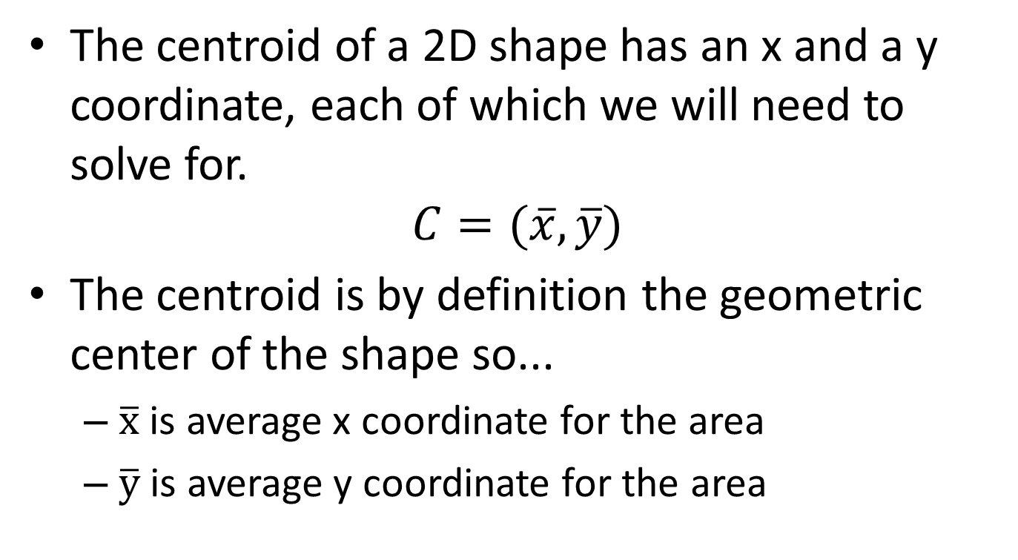
Finding the Centroid
The centroid of a 2D shape has an x and a y coordinate, each of which we will need to solve for.
$$C=(\overline{x},\overline{y})$$
The centroid is by definition the geometric center of the shape so...
$\overline{x}$ is average x coordinate for the area
$\overline{y}$ is average y coordinate for the area

Slide 4
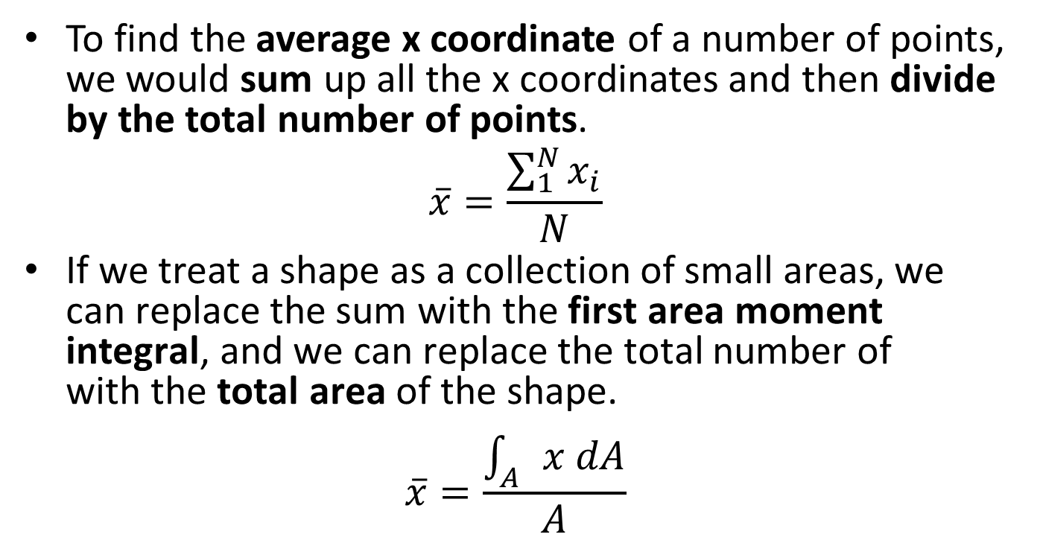
Finding the Centroid via Integration
To find the average x coordinate of a number of points, we would sum up all the x coordinates and then divide by the total number of points.
$$\overline{x}=\frac{\sum_{1}^{N}{x_{i}}}{N}$$
If we treat a shape as a collection of small areas, we can replace the sum with the first area moment integral, and we can replace the total number of points with the total area of the shape.
$$\overline{x}=\frac{\int_{A}{x dA}}{A}$$

Slide 5
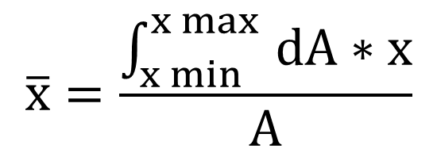

Finding the Centroid
The equation describing the height of the shape at any given value of x times dx
y
The x position of the rightmost point on your shape
$$dA$$
$$\overline{x}=\frac{\int_{x min}^{x max }{dA∗x}}{A}$$
x
The x position of the centroid
The total area of the shape
x min
x max
The x position of the leftmost point on your shape

Slide 6
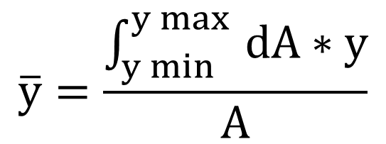

Finding the Centroid
The equation describing the width of the shape at any given value of y times dy
The y position of the topmost point on your shape
y
y max
$$\overline{y}=\frac{\int_{y min}^{y max }{dA∗y}}{A}$$
$$dA$$
y min
x
The y position of the centroid
The total area of the shape
The y position of the bottommost point on your shape

Slide 7
Thanks for Watching
See other engineering mechanics videos and access the full tool at…

Slide 8
Finding the Centroid Worked Example
Find the centroid of the shape shown below.
y
4 in
x
6 in

Slide 9
Finding the Centroid Worked Example
Find the centroid of the shape shown below.
y
2 in
1 in
x
1 in
2 in

Slide 10
Finding the Centroid Practice Problem
Find the centroid of the shape shown below.
y
3 in
x
3 in
6 in

